Slide 1

Getting Help
An Introduction to Programming in Python
Notes:
Let's learn about Getting Help.

Slide 2

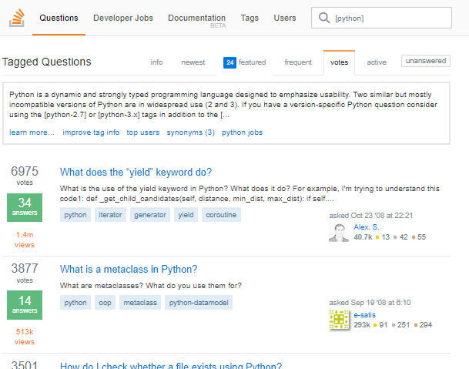
How to Get Help
HELP!
https://stackoverflow.com/help/how-to-ask
Notes:
Problems happen.
Even professional programmers ask each other for help.
It is important that you ask for help as effectively as possible.
Whether you're writing to the instructor for help, posting on the forum, or using a site like Stack Overflow, there are a few steps to keep in mind.

Slide 3
1) Write a good title
Good
Bad
How do I import a module?
What do you use a FOR loop to do?
What is wrong with my list summation?
Can't figure this out
HELP
I GIVE UP
What's the answer to #5?
Notes:
Keep the title concise and specific.
Quickly orient the reader to your intended question.
Pretend you're writing to a very busy colleague and don't waste their time.
Sometimes, it helps to write the title after you've written the rest of the question.

Slide 4
2) Describe Desired Functionality
"My program is supposed to take in a list of numbers and print their sum."
"I am trying to write a summation function."
"In this part of the program, I am attempting to open a file and read its contents…"
Notes:
Next, in the body of your email or post, clearly describe what you are trying to make your program do.
If possible, also clearly describe any inputs to your program, and what you expected it to do.

Slide 5
3) Describe Problem/Errors
"Instead, it always returns zero."
"Instead, I get the following error (attached)."
"Instead, the computer catches fire and sparks fly out."
Notes:
Third, describe what is going wrong.
If possible, give the exact, specific error message you are getting.
If there is no error, then precisely describe what you think is going wrong.

Slide 6
4) What Have You Done?
Good
Bad
print("Finding volume")
area = length * width
volume = height * area
print(volume)
OR
https://pastebin.com/d9w9Sd41
print("Finding volume")area = length ** widthvolume = height * areaprint(volume)
Notes:
A major goal is to let others reproduce the problem themselves.
Therefore, including your code or answer is crucial.
When pasting code, pay attention to formatting and make sure that it was not changed.
Consider using a site like "https://pastebin.com" to transfer the code, or send the Python file directly.

Slide 7

Grammar, Spelling, and Punctuation
LOL profesor dude culd i get help on #4 thanx
Notes:
Communicating clearly is a hallmark of a professional, no matter what discipline you're in.
Although grammar, spelling, and punctuation may seem distracting, they are important.
If the reader cannot understand you, it will take a very long time to get the help you want.

